Slide 1
Building Histogram on Large Datasets in Apache Flink
BDAPRO
Dieu Tran, Pandu Wicaksono, Shibo Cheng
2018-01-22

Slide 2
Agenda
Introduction
Progress
Difficulties
Next Plan

Slide 3
Introduction

Slide 4
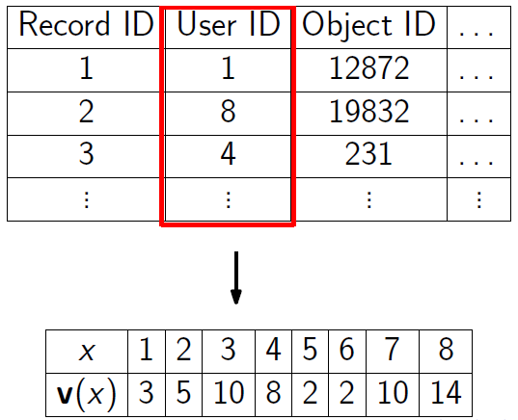
Histogram
A widely accepted and utilized summarization tools.
For an attribute x, domain of the attribute is finite and v(x) is the frequency vector of x.
A histogram is any compact (lossy) representation of v.
Domain
Frequency
Image Source: [1,2]

Slide 5
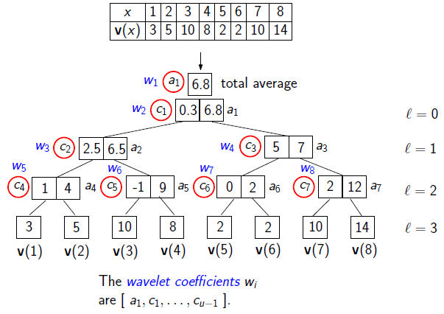
Wavelet Histogram
A common choice for a histogram is Haar wavelet histogram.
Obtain the wavelet coefficients recursively.
We can select the top k coefficients → can be used to reconstruct the data.
Image Source: [1,2]

Slide 6
Histogram on Large Dataset [1,2]
An algorithm to build histogram on large dataset using MapReduce was proposed.
The research measured the efficiency of the proposed algorithm in terms of running time (IO and computation) and network communication.
The proposed algorithm:
Two exact solutions
Two approximate solutions

Slide 7
Goal
Main Goal: implement the proposed algorithm in Flink and reproduce the experiment suggested in the research.
Algorithms:
Exact Solution
Send V
Send Coef
H-WTopK
Approximate solution.
Improved-S
TwoLevel-S
Preferable datasets:
WorldCup dataset. [3]
Synthethic dataset with Zypfian distribution.

Slide 8
Progress

Slide 9
Progress as of 23 January 2018
Main focus: implement the exact solution and perform initial experiment.
Implemented task:
Dataset preprocessing
Send V and Send Coef. algorithm implementation
SSE calculation from the algorithm result
Initial experiment on cluster
Reasons:
The exact solution is the easiest of the algorithm to implement.
Preprocessing the dataset requires a lot of time (1.35 billion records).
Need time to adapt using the cluster.
Need time to set up the experiment (evaluation metrics, configuration, etc.).
Avoid repeating the experiment (for example because the metrics is missing).

Slide 10
Dataset Preprocessing
Data Source
WorldCup dataset
245 .txt files
{CID, OID, Timestamps}
245 .gzip files
245 binary files
(8 fields)
400 million records of mapping file
[1, 2^29]
{CID_OID, ID}
1.35 billion records of data files
{ID,ID,ID,ID…
ID,ID,ID,ID…}
1 file one file

Slide 11
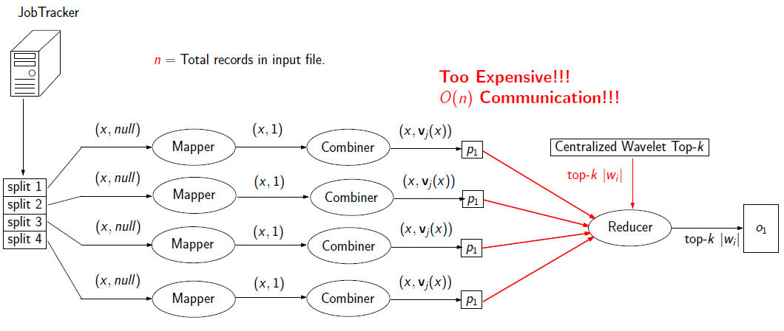
Implemented Algorithm (Send V and Send Coef)
Send V → calculate the frequency in worker and send the frequency.
Send Coef. → calculate the local wavelet tree and send their coefficient.
Image Source: [1,2]

Slide 12
SSE Calculation
Send V and Send Coef. write an output file containing the top k coefficient of the wavelet tree.
Implement a program to have this data as an input and reconstruct the data.
Compare the actual data with the reconstructed data to get the SSE.

Slide 13
Results
Send V worked as intended (SSE = 0).
Send Coef. was taking too much time, hence we stopped the execution (in the paper, they also stopped the execution and didn’t present the result of Send Coef.)
Send V’s overall running time was around 2.5 hours → the other algorithm should be less than this time since Send V is the exact solution.

Slide 14
Analysis
XXX to be updated with the result.

Slide 15
Difficulties

Slide 16
Implementing the algorithm
Reading the paper and understanding the algorithm from it was hard.
Many mathematical notation.
Sometimes the explanation is not very clear.
Cannot directly implement the algorithm in Flink.
Plan to deal with the problem:
Search for another source to help → we have obtained a slides from the same author that explains the implementation.
Search for the implementation source code → we have obtained the research implementation source code in MR.

Slide 17
Getting the metrics from Flink
First time using Flink and cluster to run the experiment.
Don’t really know from which data the metrics is obtained (Flink log / GUI interface / etc.)
Plan to deal with the problem:
Reading through the Flink documentation.
Asking a more experienced Flink user.

Slide 18
Next Plan

Slide 19
Timeline

Slide 20
References
[1] Jestes, Jeffrey, Ke Yi, and Feifei Li. Building wavelet histograms on large data in MapReduce. Presentation Slides from https://www.cs.utah.edu/~lifeifei/papers/histogramSlides.pdf (Accessed 18 January 2018).
[2] Jestes, Jeffrey, Ke Yi, and Feifei Li. Building wavelet histograms on large data in MapReduce. Proceedings of the VLDB Endowment 5.2 (2011): 109-120.
[3] M. Arlitt and T. Jin. Workload characterization of the 1998 world cup web site. Technical report, IEEE Network, 1999.

